Slide 1
SYX Ltd has 13 years in led display industry
Die Casting Cnc Machining Assembly Accessory
Brochure
PART01
PART02
PART03
Service
Accessory
CONTACT US
http://www.gdszsyx.com/product-category/die-cast-led-display-cabinet/

Slide 2
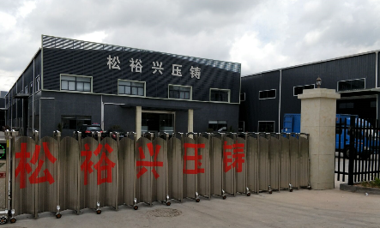
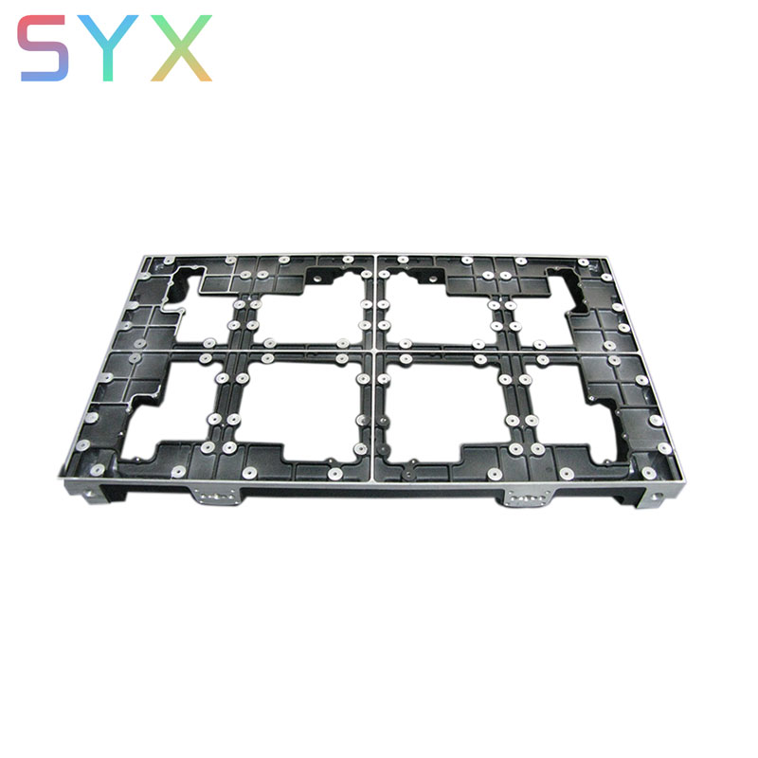
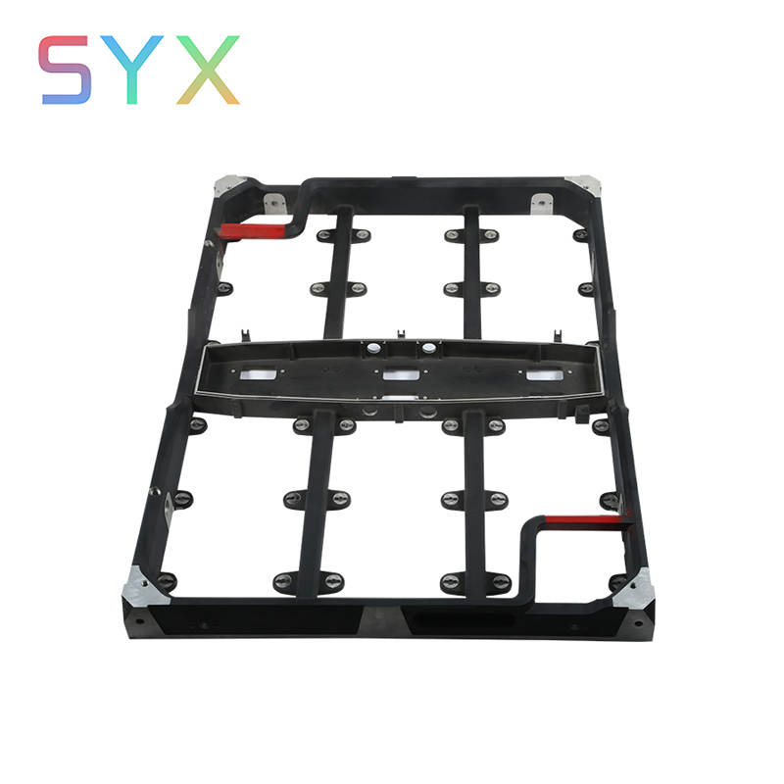
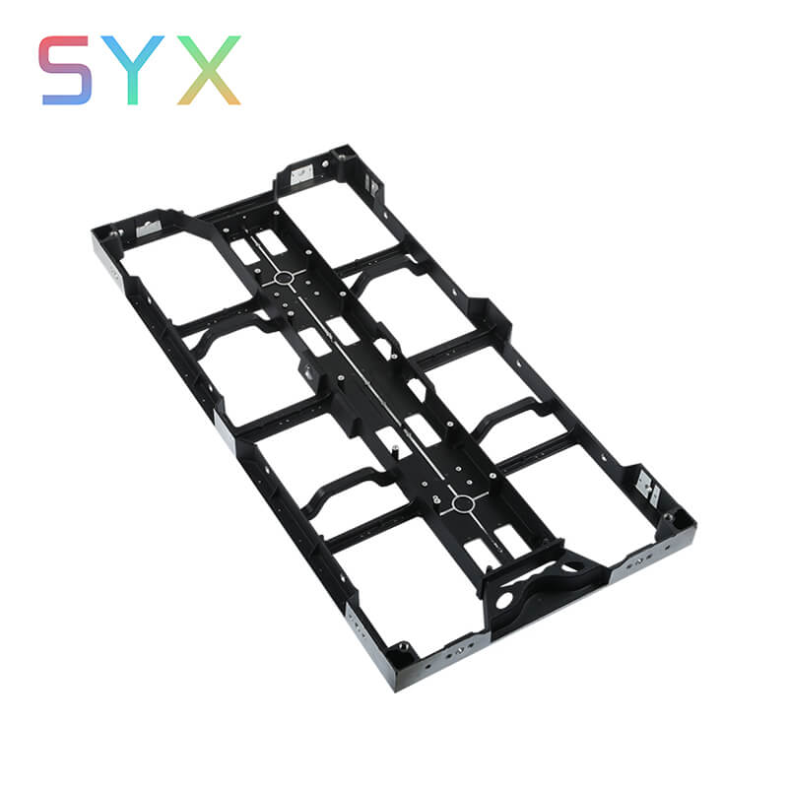
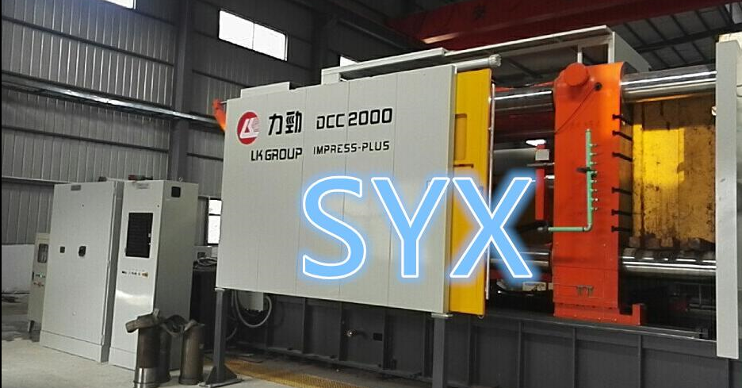
BUSINESS INTRODUCTION
Die Casting
PART 01
SYX Limited supply a whole completed line construction service for led display : Design , Prototype,mould making,Die casting,CNC Machining and Powder spraying&Silk-printing,Assembly .
we are custom precision metal component company and one stop Metal Fabrication Manufacturer in China.near HongKong,shenzhen. Covers about 10,000 square meters of factory.Accredited ISO/TS16949 .
custom die casting canbinet showroom
Small pitch die-casting canbinet
1024*768mm canbinet
1000*500mm canbinet

Slide 3
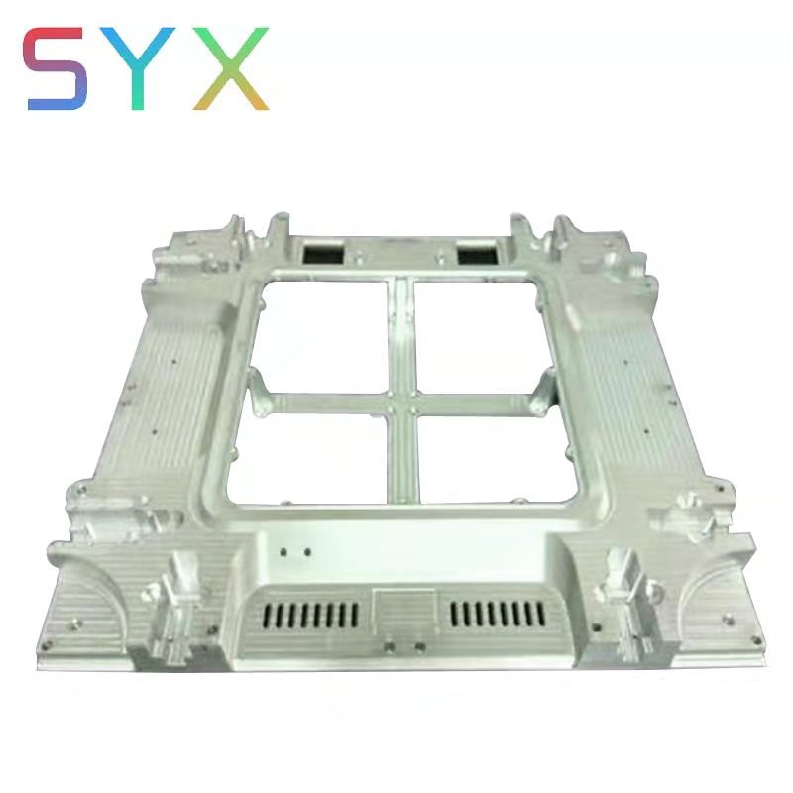
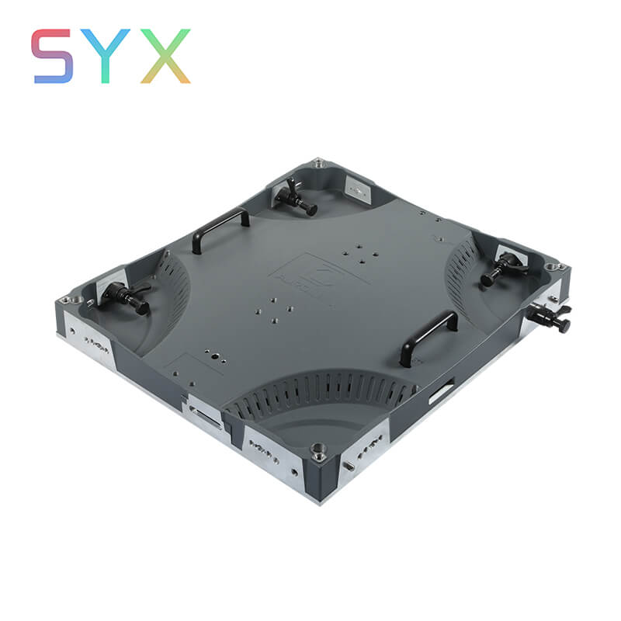
BUSINESS INTRODUCTION
CNC Machining
Prototype
Cnc Machining with assembly
50set cnc machining machine for metal prototype:aluminium, zinc,copper,extrusion
For Led display max:1024*768, 100*500,etc and high precision for small pitch Led display .6 sets-4_axle cnc machining

Slide 4
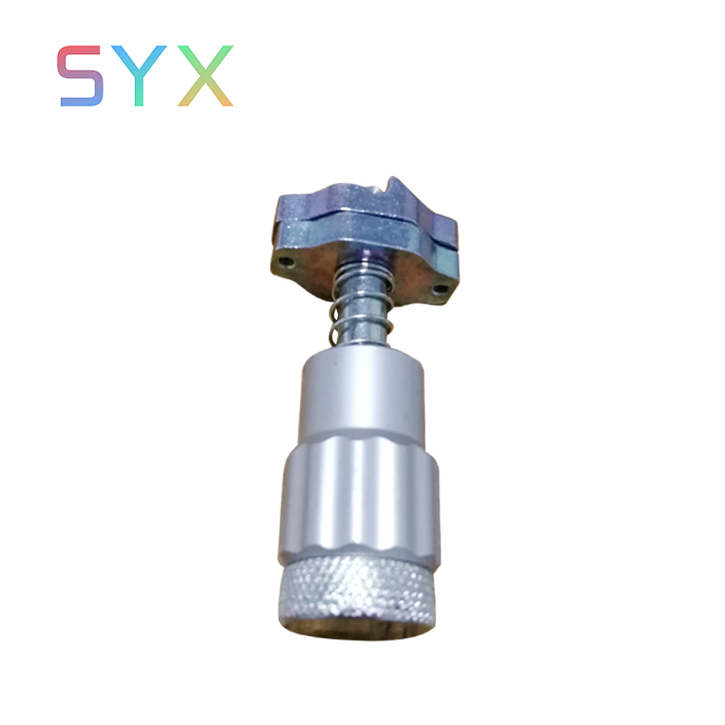
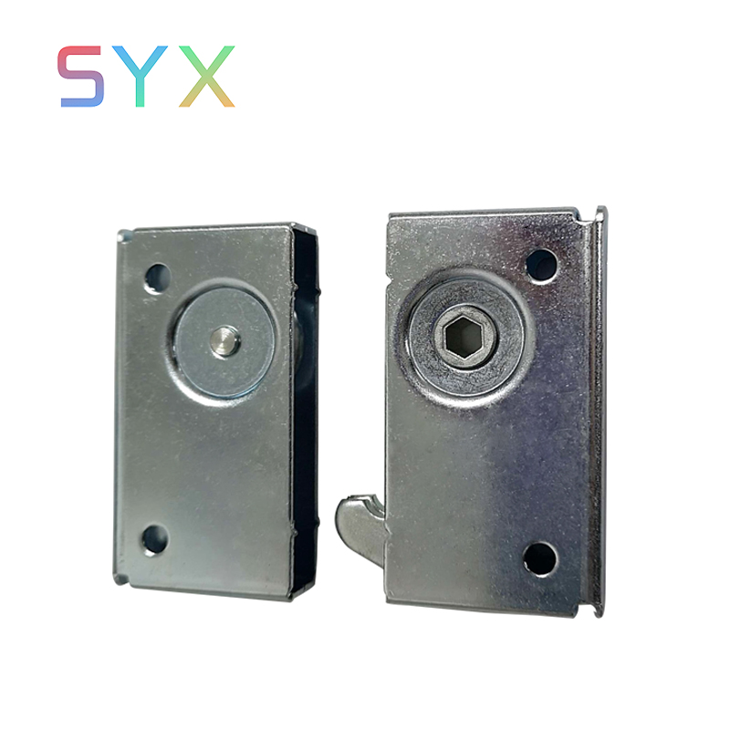
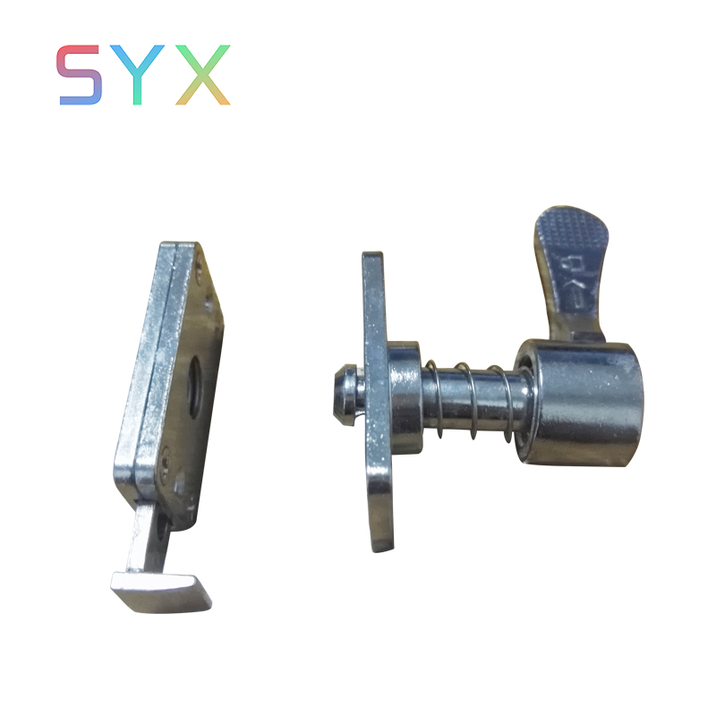
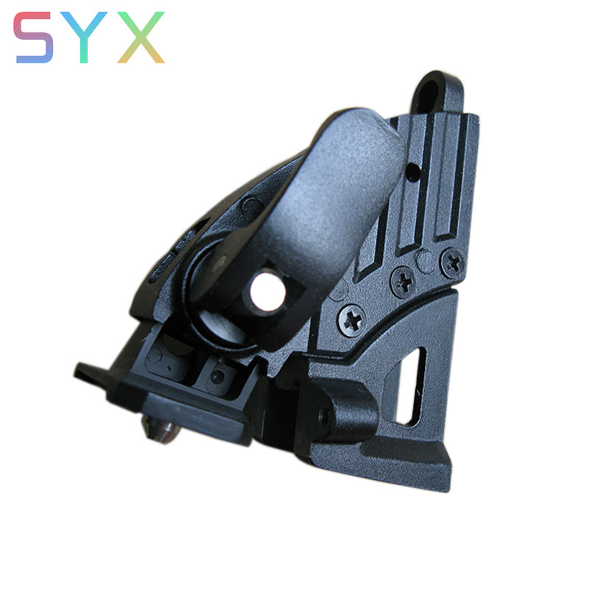
Led display component
PART 02
quick lock syx 01
latch
，
quick lock syx 02
curve display lock
，

Slide 5
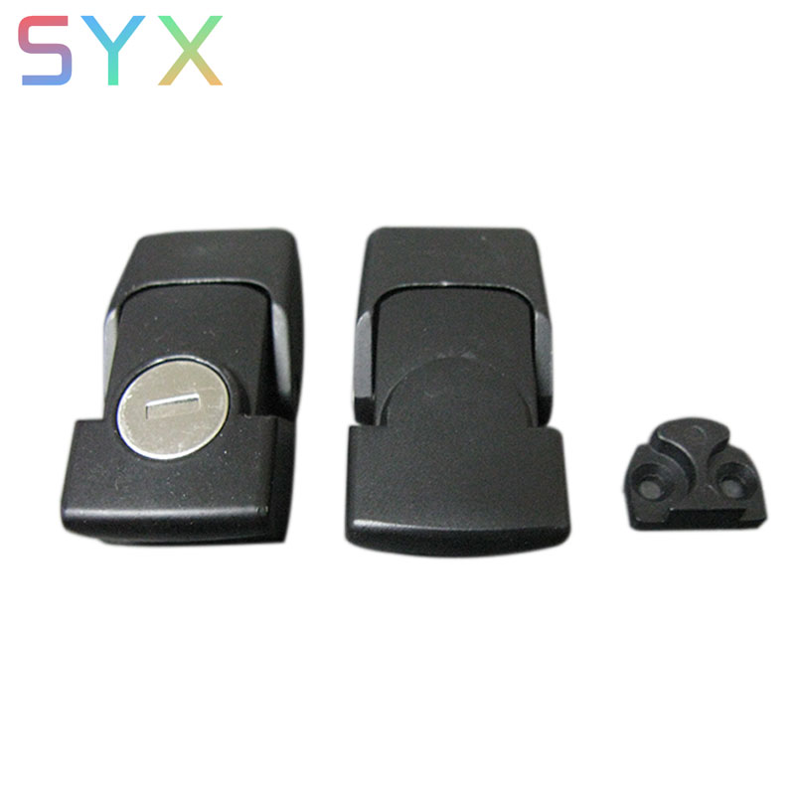
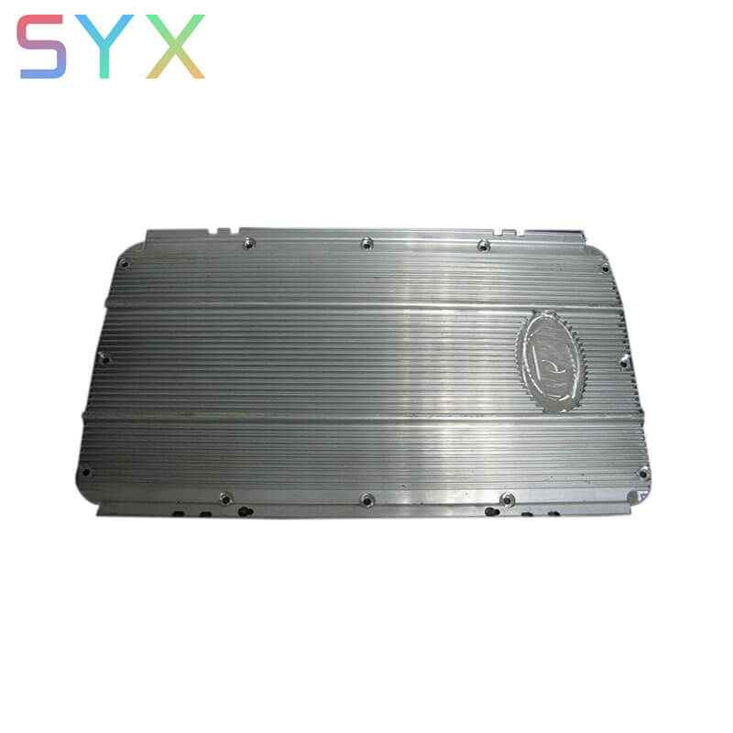
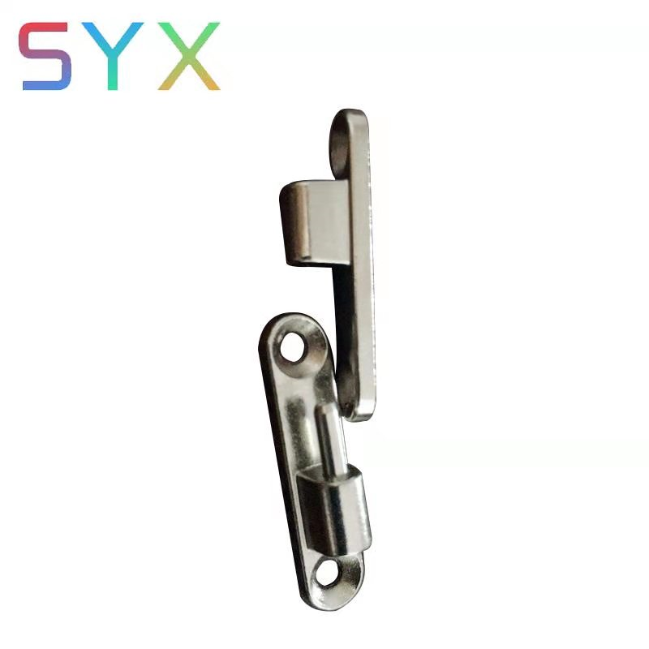
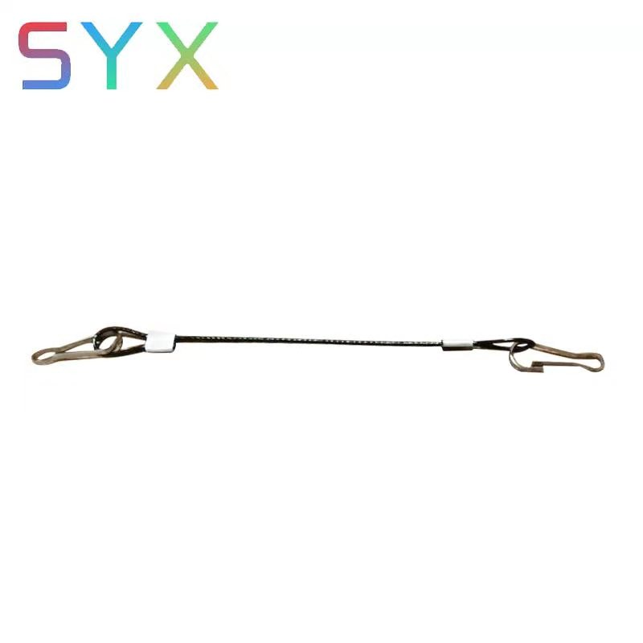
Led display component
PART 02
power box lock
Cover by aluminum extrusion
，
，
hinge
safe line

Slide 6
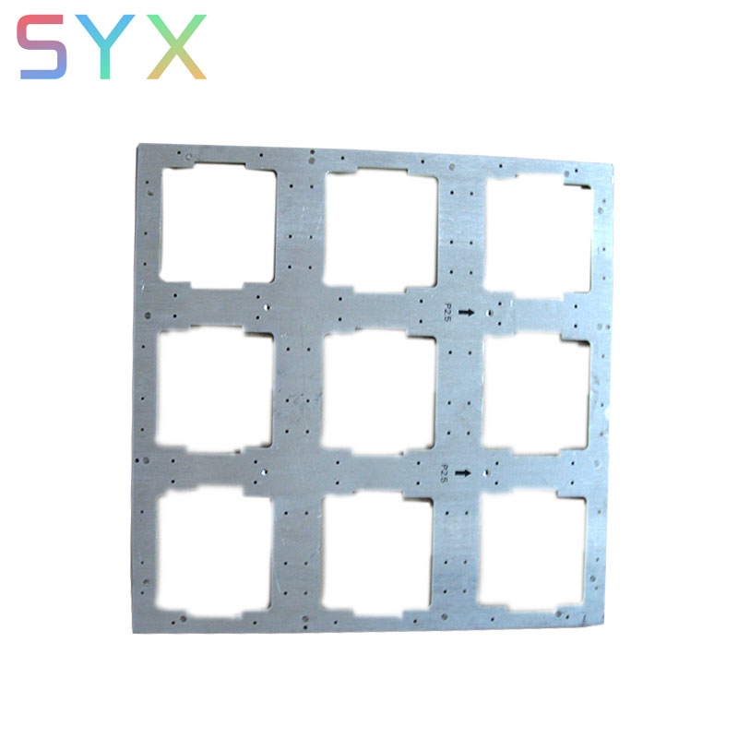
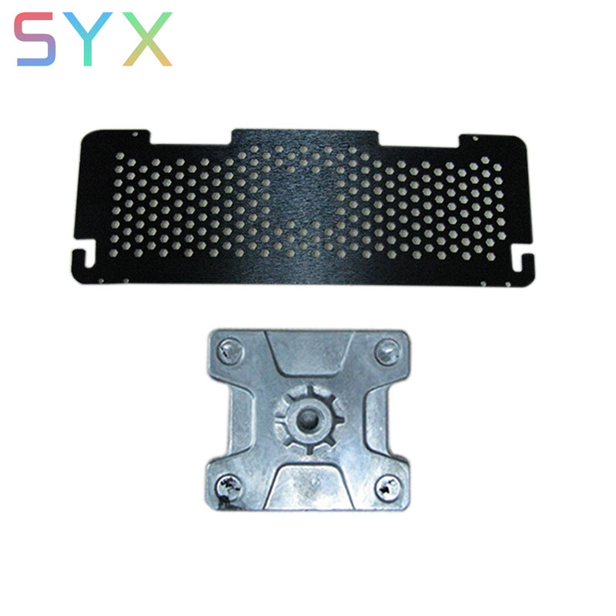
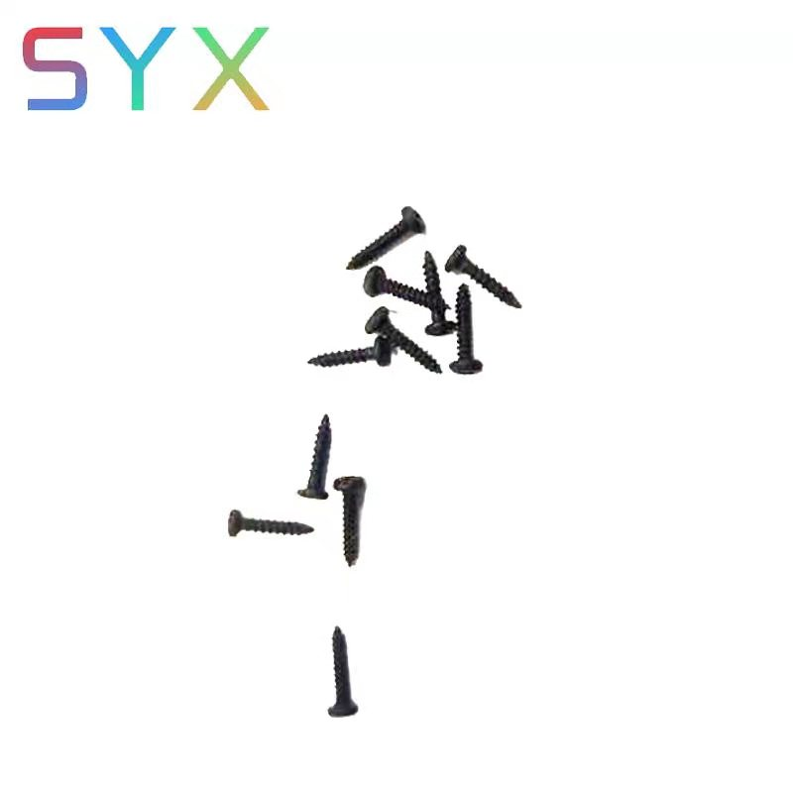
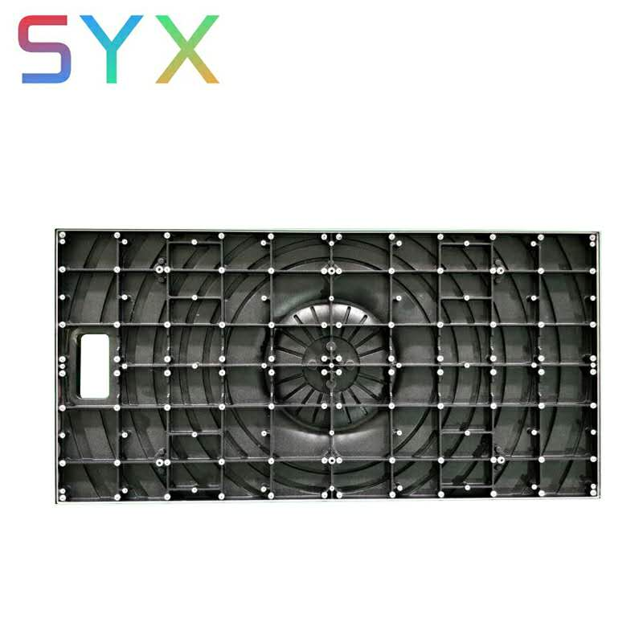
Led display component
PART 02
connect plate
aluminum moudle plate
，
module screw
aluminium die cating moudle
，

Slide 7
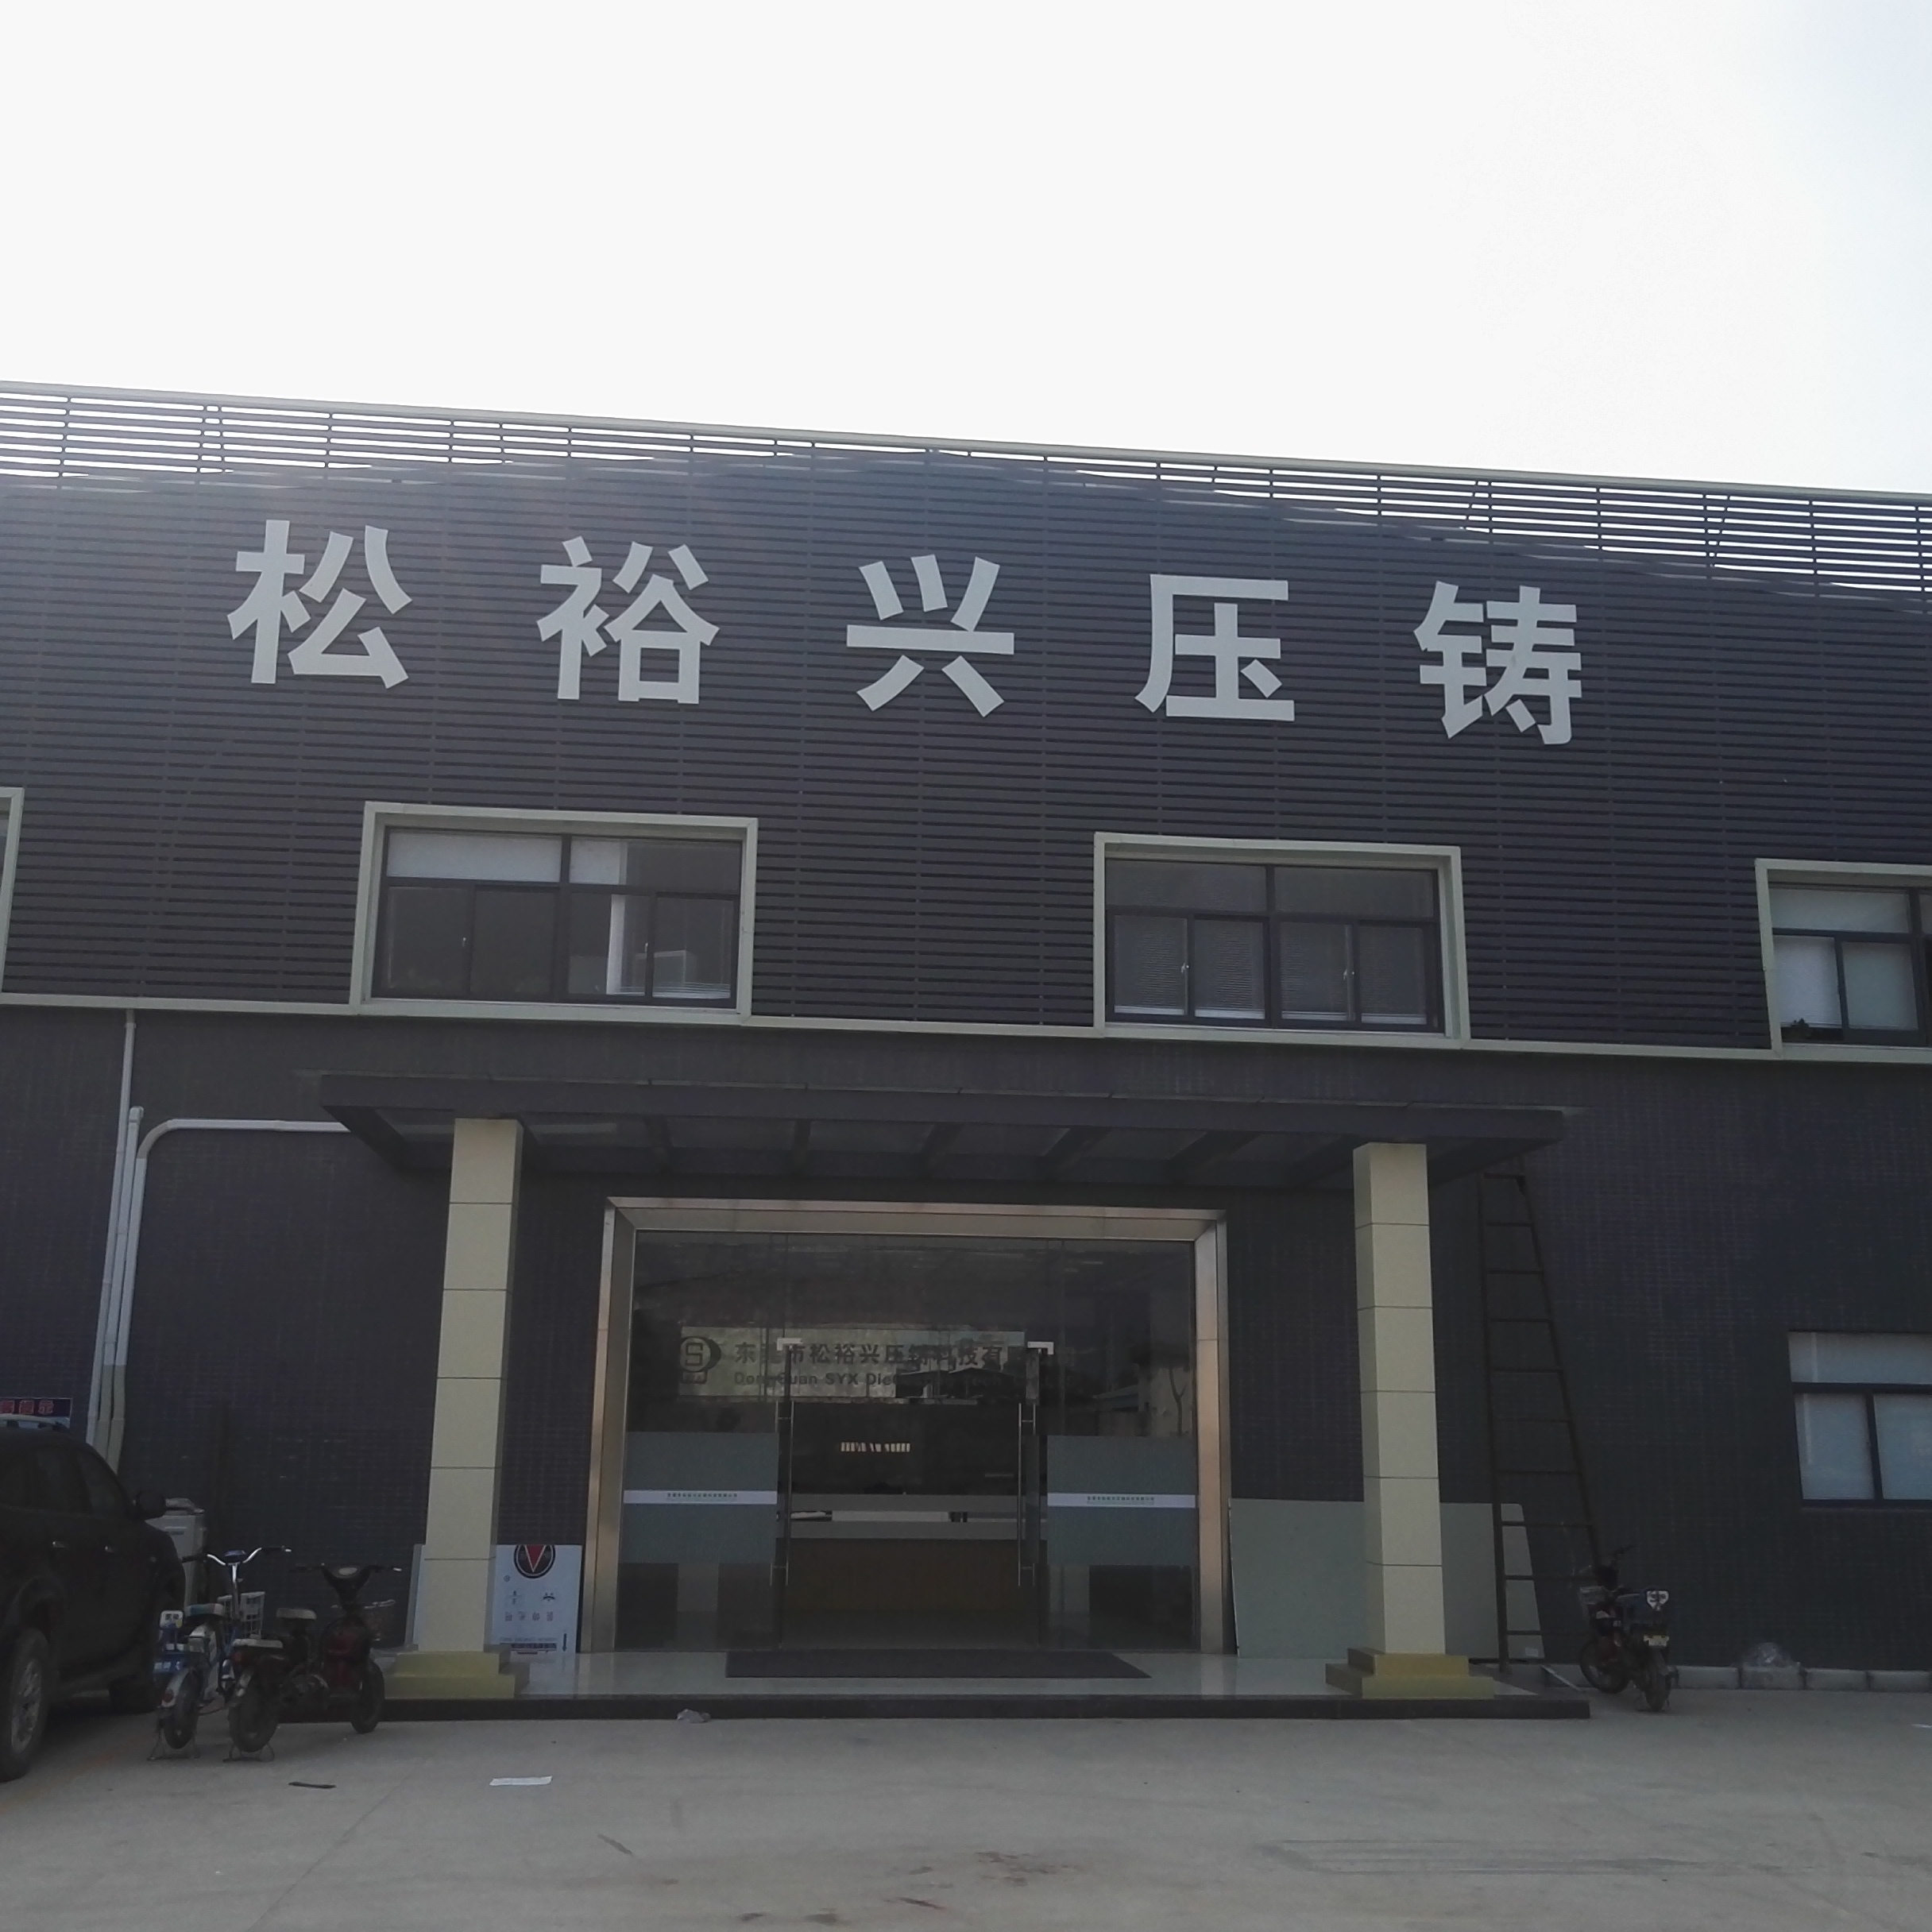
CONTACT US
PART 03
CUSTOMERS
Name: Dongguan syx die casting tech.co.,ltd (SYX Limited))
ADDRESS-KaiDa Industrial Park B10, QiaoChang Road, Qiaotou Town, Dongguan, Guangdong, China
Phone: 0086-0769-81022289 FAX:0086-0769-81022292
whatapp: +86-18676679161 Email:gdszsyx@gmail.com;sales@gdszsyx.com
SKYPE: GDSZSYX
Website :www.gdszsyx.com

